Slide 1
Task 2: Find the vulnerabilities from the given website http://testasp.vulnweb.com/.
Summary:
Communication is made over unsecure, unencrypted HTTP. We noticed that the communication between the web browser and the server is done using the HTTP protocol, which transmits data unencrypted over the network. The risk is that an attacker who manages to intercept the communication at the network level can read and modify the data transmitted (including passwords, secret tokens, credit card information and other sensitive data).
It has an endpoint that is vulnerable to an injection vulnerability - namely a reflected injection of JavaScript, also known as Reflected Cross Site Scripting (XSS). As per OWASP's definition: "Cross-Site Scripting (XSS) attacks are a type of injection, in which malicious scripts are injected into otherwise benign and trusted websites. "This happens because one of the GET parameters "p" does not properly sanitize/escape user input, allowing an injection to occur.

Slide 2
Vulnerability details:
Attack Vector: <svg onload = alert(1)>
Vulnerability type: Reflected XSS
Security level: high
Explanation:
The injected SVG element contains an onload event with a JavaScript alert(1) function. When the SVG element loads, the JavaScript code executes, displaying an alert box. This demonstrates that user input is not properly sanitized or escaped, allowing the execution of arbitrary JavaScript code.
Impact:
User Impact: The vulnerability can be exploited to execute arbitrary JavaScript in the user's browser, leading to potential data theft, session hijacking, defacement, or malware distribution.
Business Impact: Exploitation of this vulnerability can damage the organization's reputation, lead to loss of user trust, and potentially result in legal consequences and financial loss.

Slide 3
Reproduction Steps:
Open this site.
Locate an input field or parameter that reflects user input on the page.
Insert the following payload into the input field or URL parameter:
<svg onload=alert(1)>
4. Submit the input.
5. Observe the alert box displaying the message "1", indicating the execution of the injected
JavaScript code.

Slide 4
Recommended Mitigation:
Input Validation: Ensure that all user inputs are validated on the server side. Reject inputs containing potentially malicious characters or scripts.
Output Encoding: Properly encode all outputs. Use context-aware encoding to prevent script execution (e.g., HTML encoding, JavaScript encoding).
Content Security Policy (CSP): Implement a strong Content Security Policy to restrict the sources from which scripts can be executed.
Sanitization Libraries: Utilize well-established libraries to sanitize user inputs (e.g., DOMPurify for JavaScript).
Regular Security Testing: Perform regular security assessments, including automated and manual testing, to identify and address vulnerabilities.

Slide 5
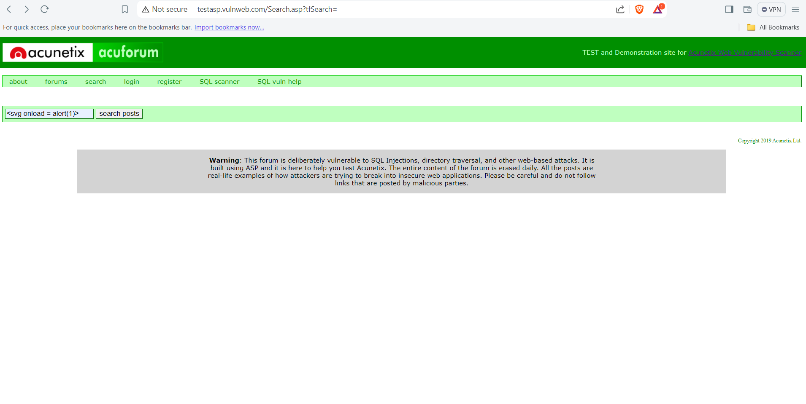
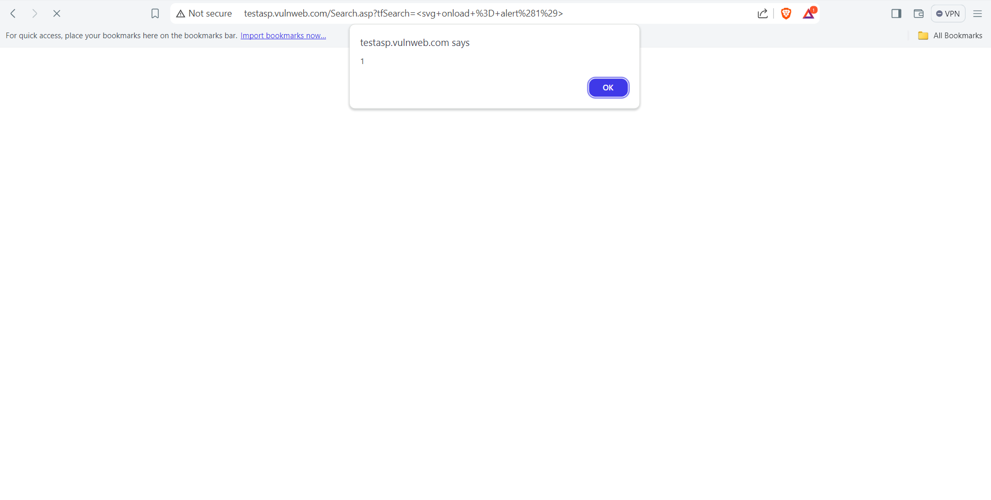
Demonstartion:

Slide 6
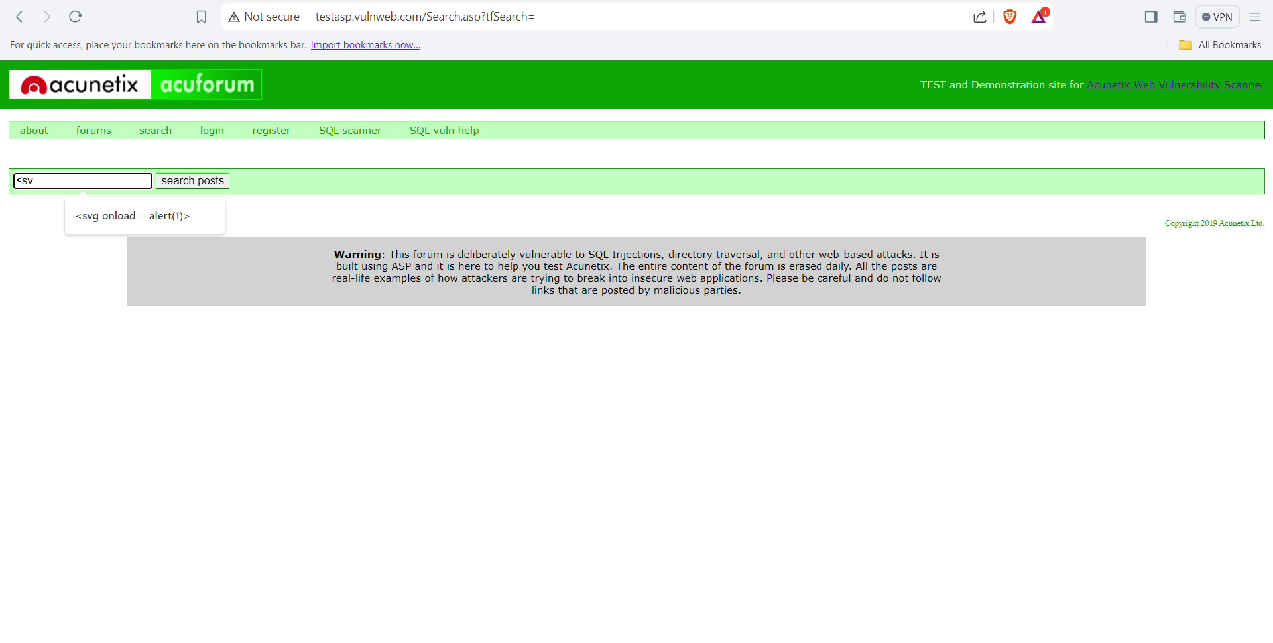

Slide 7
Conclusion:
The identification of this XSS vulnerability highlights the importance of secure coding practices and regular security testing. By addressing this issue promptly and implementing the recommended mitigation steps, the risk of exploitation can be significantly reduced, ensuring a safer user experience.

